Slide 1
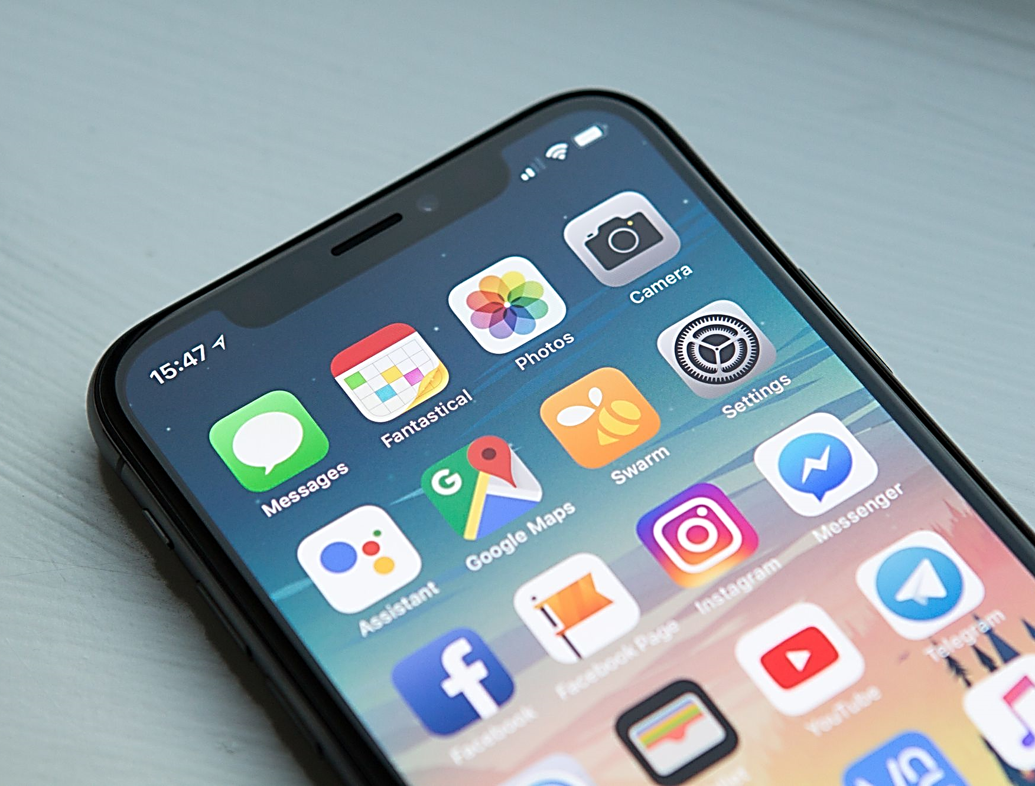
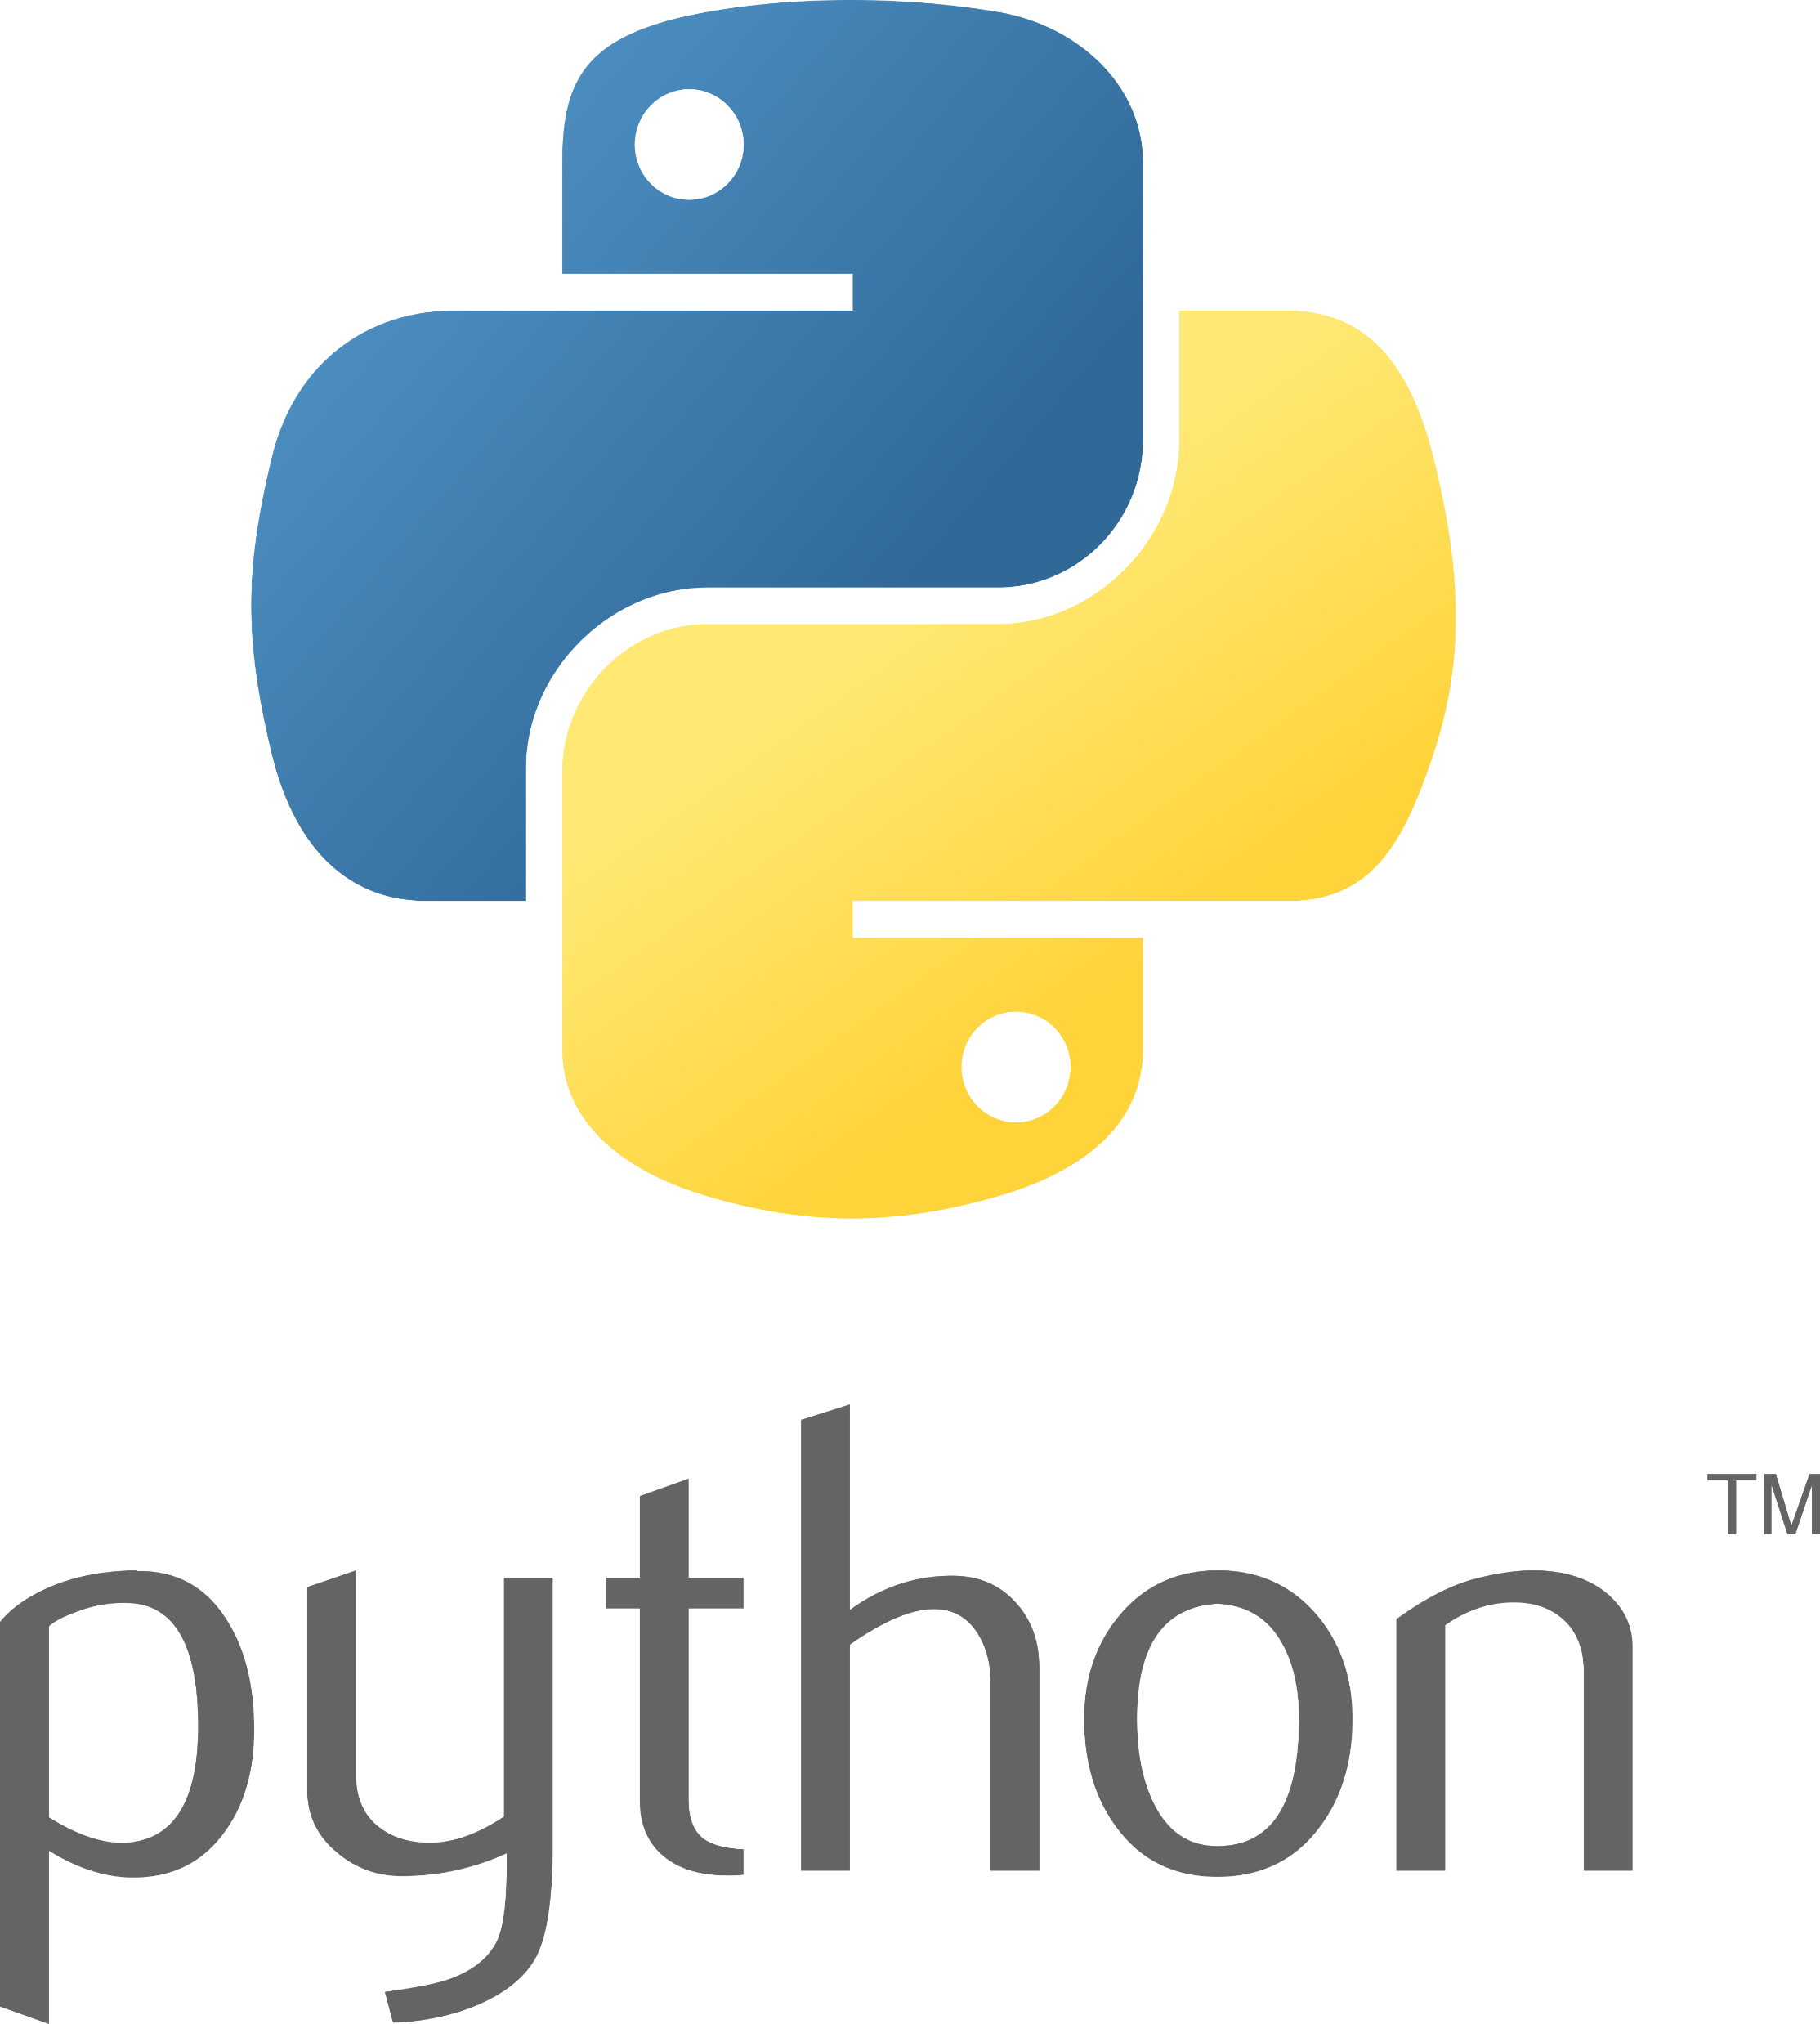

Mobile Apps Programming
P E D Putra, M.Si.
Lecture 3 – Creating Labels, Text Styles, and Button

Slide 2

Box-Layout in Kivy
The BoxLayout class is used to arrange child widgets in a linear, either horizontal or vertical, fashion. It inherits from the Layout class in Kivy, which is the base class for all layout widgets.
Load as
from kivy.uix.boxlayout import BoxLayout
Whats BoxLayout gives you?!
Properties
‘orientation’ (StringProperty, default: 'horizontal’): Specifies the orientation of the layout. It can be set to 'horizontal' or 'vertical'.
‘spacing’ (NumericProperty, default: 0): The space between children in pixels.
‘padding’ (NumericProperty, default: 0): The space between the layout box and its children.
Methods
add_widget(widget, index=0, canvas=None): Adds a widget to the layout. You can specify the index where the widget should be added.
remove_widget(widget): Removes a widget from the layout.

Slide 3
Label in Kivy
The Label class is a widget that displays a text string.
Load as
from kivy.uix.label import Label
Whats Label gives you?!
Properties
‘text’ (StringProperty, default: ‘ ‘): The text to be displayed.
‘font_size’ (NumericProperty, default: 15): Font size of the text.
‘font_name’ (StringProperty, default: ''): Name of the font to be used.
‘bold’ (BooleanProperty, default: False)
‘italic’ (BooleanProperty, default: False)
‘underline’ (BooleanProperty, default: False)
‘color’ (ListProperty, default: [1, 1, 1, 1]): Color of the text in the format [r, g, b, a], where each component is a float between 0 and 1.
Methods
texture_update(): Forces an update of the texture. Useful when modifying the text or its properties dynamically.
Check documentation for details

Slide 4
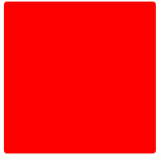
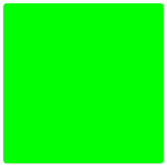
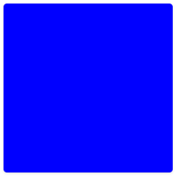
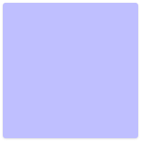
Label color in Kivy
In Kivy, color values are specified using the Red, Green, Blue, and Alpha (RGBA) format.
Example:
rgba(255, 0, 0, 1)
rgba(0, 255, 0, 1)
rgba(0, 0, 255, 1)
rgba(0, 0, 255, 0.25)
Check rgbacolorpicker.com for details

Slide 5
Font Type in Kivy
To replace the font type (font family) for a Kivy Label, you can use the font_name property.
By default, a system-installed font, set
font_name='Arial'
Kivy comes with a default set of fonts that are available without the need for additional registration. Here are some of the standard fonts you can use in Kivy:
Default Sans-serif Font:
'default' or 'sans-serif'
Default Monospace Font:
'monospace'
Default Serif Font:
'serif'

Slide 6
Work with one widget, Label-color
from kivy.app import App
from kivy.uix.boxlayout import BoxLayout
from kivy.uix.label import Label
class MyBoxLayout(BoxLayout):
def __init__(self, **kwargs):
super(MyBoxLayout, self).__init__(**kwargs)
label = Label(
text="Custom Text Style",
font_size='20sp',
font_name='Calibri',
color=(1, 0, 0, 1),
bold=False,
italic=True,
underline=True)
self.add_widget(label)
class MyApp(App):
def build(self):
return MyBoxLayout()
if __name__ == '__main__':
MyApp().run()

Slide 7
Work with one widget, Label-color
Do the same, but change the color to Blue (25%), font type Calibri, font size 11, Bold.

Slide 8
Work with Two widget, Label-color
Add one more widget by setting self.add_widget(label2)

Slide 9
Work with Two widget, Label-color
Set the Label at the bottom side and make it centered by setting
height=50, # Adjust the height as needed
pos_hint={'center_x': 0.5} # Center the label horizontally

Slide 10
Interactive Button Label
In Kivy, the ButtonBehavior is a mixin class provided to enable touch-based interactions for widgets.
Load as
from kivy.uix.behaviors import ButtonBehavior
Touch Events:
ButtonBehavior provides methods to handle touch events such as on_touch_down, on_touch_move, and on_touch_up.
States
ButtonBehavior introduces states like down and disabled, which are useful for visual feedback.
It introduces properties such as background_normal and background_down that allow you to specify different background images or colors for the widget in different states.
Properties
Click Handling
The ButtonBehavior class includes logic for handling clicks, and it can trigger the on_press and on_release events.

Slide 11
Interactive Button Label
In Kivy, the ButtonBehavior is a mixin class provided to enable touch-based interactions for widgets.
Load as
from kivy.uix.behaviors import ButtonBehavior
class ColorChangingLabel(ButtonBehavior, Label):
def __init__(self, **kwargs):
super(ColorChangingLabel, self).__init__(**kwargs)
self.original_color = self.color # Store the original color
def on_touch_down(self, touch):
if self.collide_point(*touch.pos):
self.color = (0, 1, 0, 1) # Green color
return super(ColorChangingLabel, self).on_touch_down(touch)
def on_touch_up(self, touch):
if self.collide_point(*touch.pos):
self.color = self.original_color
return super(ColorChangingLabel, self).on_touch_up(touch)
Un - touched
As touched

Slide 12
Interactive Button Label
In Kivy, the ButtonBehavior is a mixin class provided to enable touch-based interactions for widgets.
Load as
from kivy.uix.behaviors import ButtonBehavior
class ColorChangingLabel(ButtonBehavior, Label):
def __init__(self, **kwargs):
super(ColorChangingLabel, self).__init__(**kwargs)
self.original_color = self.color # Store the original color
def on_touch_down(self, touch):
if self.collide_point(*touch.pos):
self.color = (0, 1, 0, 1) # Green color
return super(ColorChangingLabel, self).on_touch_down(touch)
def on_touch_up(self, touch):
if self.collide_point(*touch.pos):
self.color = self.original_color
return super(ColorChangingLabel, self).on_touch_up(touch)
This line of code is calling the constructor of the superclass ButtonBehavior

Slide 13
Interactive Button Label
In Kivy, the ButtonBehavior is a mixin class provided to enable touch-based interactions for widgets.
Load as
from kivy.uix.behaviors import ButtonBehavior
class ColorChangingLabel(ButtonBehavior, Label):
def __init__(self, **kwargs):
super(ColorChangingLabel, self).__init__(**kwargs)
self.original_color = self.color # Store the original color
def on_touch_down(self, touch):
if self.collide_point(*touch.pos):
self.color = (0, 1, 0, 1) # Green color
return super(ColorChangingLabel, self).on_touch_down(touch)
def on_touch_up(self, touch):
if self.collide_point(*touch.pos):
self.color = self.original_color
return super(ColorChangingLabel, self).on_touch_up(touch)
This line of code is calling the constructor of the superclass ButtonBehavior
As touched
Un - touched

Slide 14
Work with separated file .py and .kv
myboxlayout.kv
Why???
<MyBoxLayout>:
orientation: 'vertical'
Label:
text: "This is a plain label"
Label:
text: "[b]Bold[/b] [i]Italic[/i] [u]Underline[/u] [size=20]Size 20[/size]"
markup: True
Label:
text: "Custom Text Style"
font_size: '20sp'
color: 1, 0, 0, 1 # Red color
bold: True
italic: True
underline: True
main.py
from kivy.app import App
from kivy.uix.boxlayout import BoxLayout
from kivy.lang import Builder
Builder.load_file('myboxlayout.kv')
class MyBoxLayout(BoxLayout):
pass
class MyApp(App):
def build(self):
return MyBoxLayout()
if __name__ == '__main__':
MyApp().run()

Slide 15
Interactive Button Label -KivyMD
MDFloatingActionButton
represents a Material Design Floating action button
MDFlatButton
represents a Material Design Flat action button
Separate the files into .py and .kv
main6.py
main6.kv
from kivy.lang import Builder
from kivymd.app import MDApp
class MyApp(MDApp):
def build(self):
return Builder.load_file('main6.kv')
if __name__ == '__main__':
MyApp().run()
MDFloatLayout:
MDFlatButton:
text: "Press me"
pos_hint: {"center_x": .5, "center_y": .5}

Slide 16
Interactive Button Label -KivyMD
MDFloatingActionButton
represents a Material Design Floating action button
MDFlatButton
represents a Material Design Flat action button
Separate the files into .py and .kv
main6.py
main6.kv
Do the same
MDFloatLayout:
MDFloatingActionButton:
icon: "android"
pos_hint: {"center_x": .5, "center_y": .1}

